Slide 1
Fremont River, Part 1
In-Class Task Script
CE En 547
Brigham Young University

Slide 2
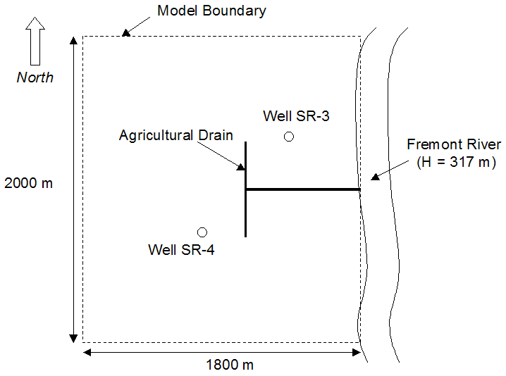

Slide 3
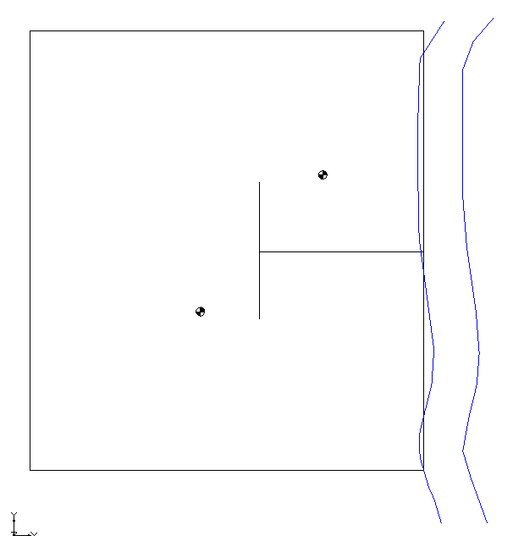
Background Image
Open map.gpr

Slide 4
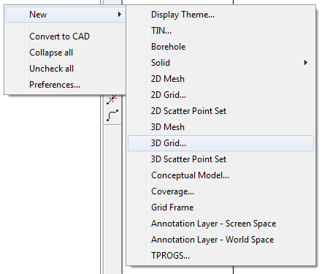
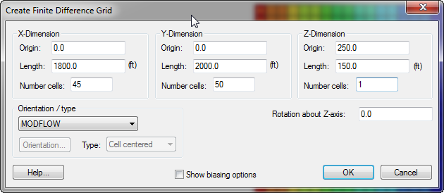
1. Create a one-layer grid

Slide 5
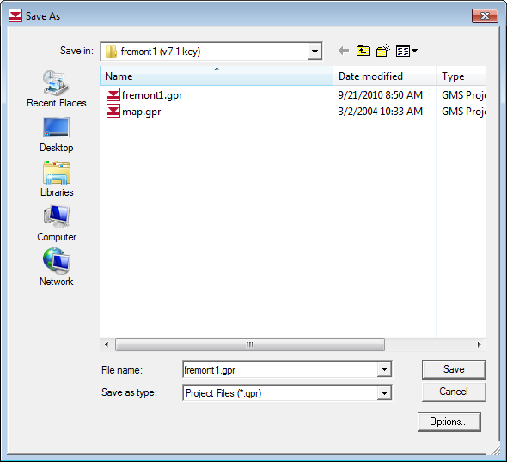
2. Save Project

Slide 6
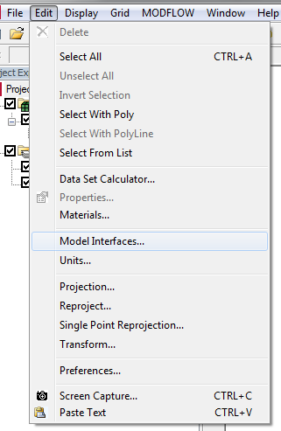
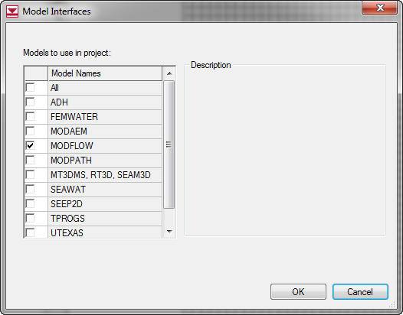
3. Turn on MODFLOW Interface
This is only necessary for some older versions of GMS. With version 9.x, the interface should already be on by default.

Slide 7
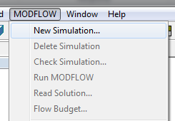
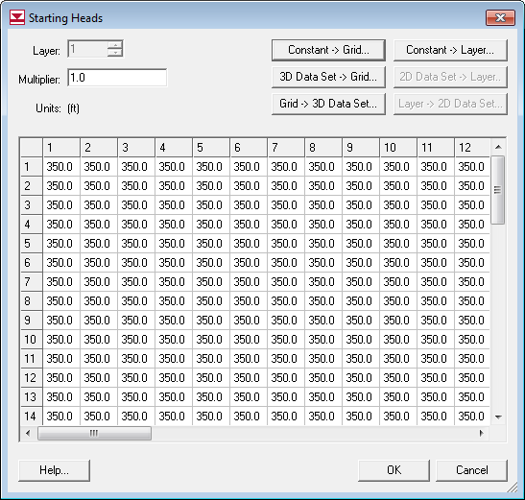
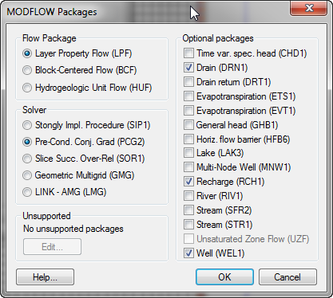
4. Initialize MODFLOW

Slide 8
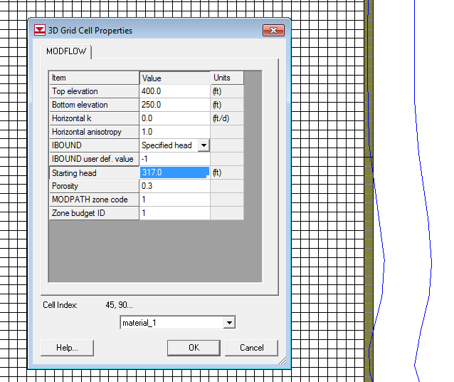
5. Constant Head on Right

Slide 9
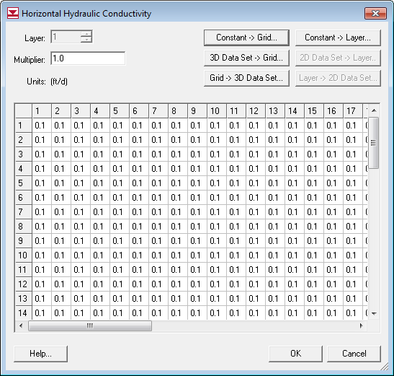
6. Enter K

Slide 10
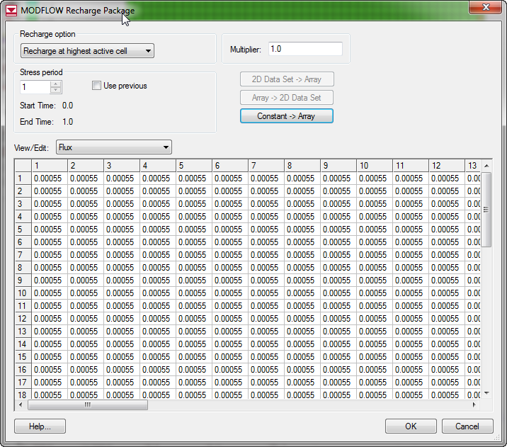
7. Enter Recharge

Slide 11
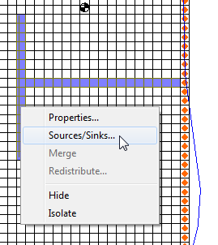
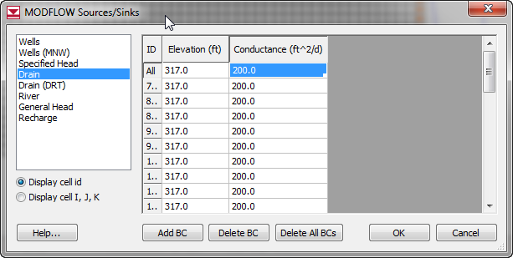
8. Create drains

Slide 12
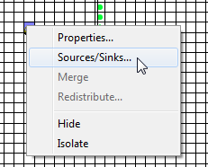
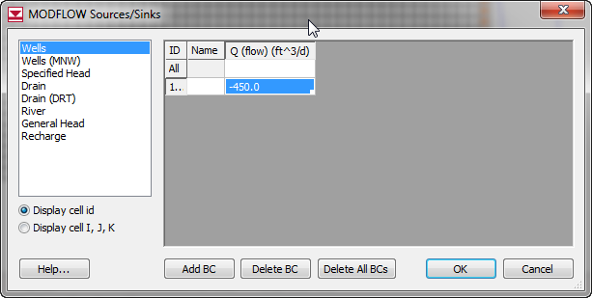
9. Create Wells
Use Q=-300 for the other one

Slide 13
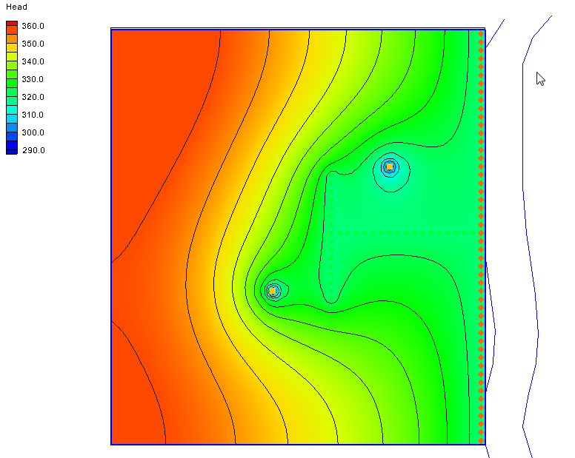
10. Check, save, and run

